Slide 1
Machine Learning With SciKit Learn
By: Satyen S.

Slide 2
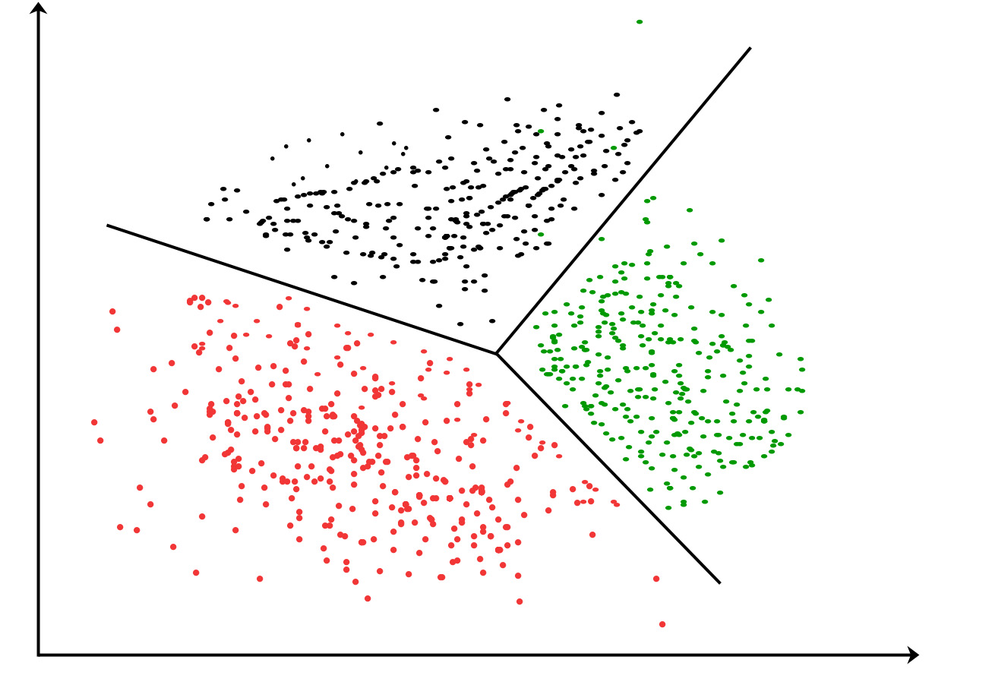
Recap: Forms of Machine Learning
Suppose I want to partition a group of students. Which machine learning technique would best suit this problem?
Supervised Learning
Unsupervised Learning
Reinforcement Learning

Slide 3
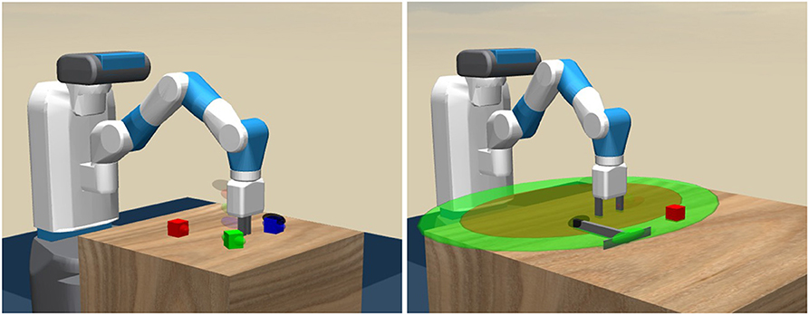
Recap: Forms of Machine Learning
Suppose I want to create an autonomous robot. Which form of machine learning would be most applicable?
Supervised Learning
Unsupervised Learning
Reinforcement Learning

Slide 4
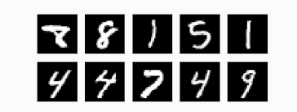
Recap: Forms of Machine Learning
Suppose I need to classify a series of images of numbers. Which form of Machine Learning would I use?
Supervised Learning
Unsupervised Learning
Reinforcement Learning
Notes:
https://scikit-learn.org/stable/auto_examples/classification/plot_digits_classification.html

Slide 5
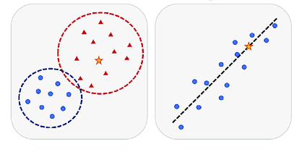
Supervised ML: Classification VS Regression
Regression: Predict a single value from an infinite range (Continuous)
Predict percentage chance of rain
Predict sales of future product
Predict future salary
Predict bond price
Classification: Predict a single value from a fixed number of values (Discrete)
Predict whether going to rain
Predict connotation of NLP text
Predict the main focus in an image
Predict bond risk

Slide 6
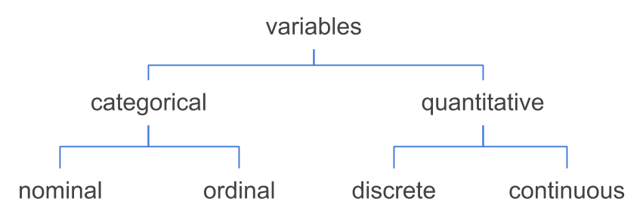
Recap: Preprocessing Techniques
To account for a nominal categorical column, which preprocessing tool would I use?
Imputer
Scaler
Normalizer
Encoder

Slide 7
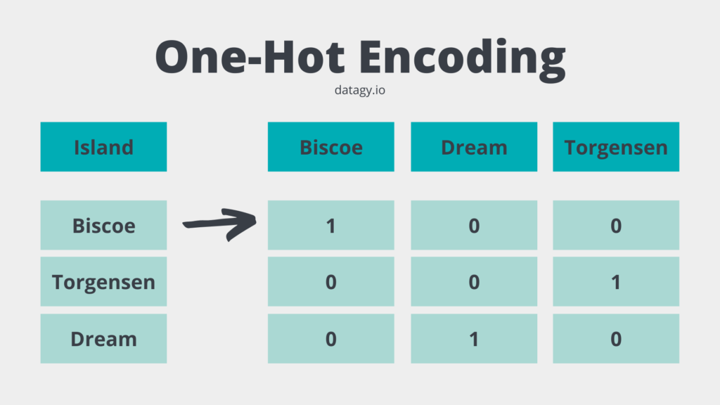
One-Hot Encoding Caveat
Depending on model, may find it helpful to remove one column from One-Hot Encoding:
Q: Why?
Note - SciKit Learn API has built in parameter for this: https://scikit-learn.org/stable/modules/generated/sklearn.preprocessing.OneHotEncoder.html

Slide 8
Recap: Preprocessing Techniques
To account for a ordinal categorical column, which preprocessing tool would I use?
Imputer
Scaler
Normalizer
Label Encoder
One-Hot Encoder

Slide 9
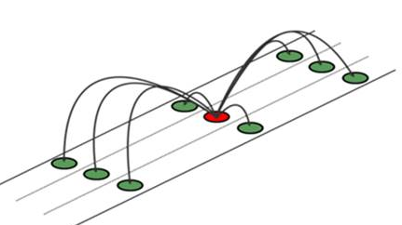
Recap: Preprocessing Techniques
To account for a null values, which preprocessing tool would I use?
Imputer
Scaler
Normalizer
Label Encoder
One-Hot Encoder

Slide 10
Libraries, References, and Tools
Block based python:
Google Colab or Juypter Notebooks (either locally or in the browser)
Preprocessing:
Numpy (programmability): https://numpy.org/doc/stable/reference/index.html
Pandas (readability): https://pandas.pydata.org/docs/reference/index.html
Visualizing:
Matplotlib (graphing input and output): https://matplotlib.org/stable/api/index.html
Machine Learning:
SciKit Learn: https://scikit-learn.org/stable/modules/classes.html
TensorFlow: https://www.tensorflow.org/api_docs
Deep Learning:
TensorFlow (industry): https://www.tensorflow.org/api_docs
PyTorch (research): https://pytorch.org/docs/stable/index.html

Slide 11
Demo: Preprocessing
Let’s do some preprocessing!
Demo: https://colab.research.google.com/drive/13iRzuGHtl8gQkjYMKySF-mkQY-3_N39o?usp=sharing
Completed: https://colab.research.google.com/drive/1bs1TYgExW0j08YAZdKVcfMT9-a99b_VJ?usp=sharing

Slide 12
Feature Selection
Remove columns with low variance
Minimize correlated columns in your dataset
Can score features by importance when training model
Feature elimination can sometimes remove noise
Importance depends on dataset
Tips: https://machinelearningmastery.com/feature-selection-with-real-and-categorical-data/

Slide 13
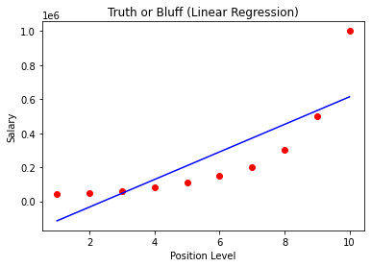
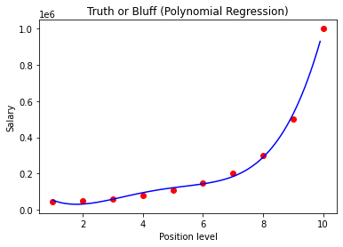
Regression Models: Linear, Polynomial, etc.
Linear
Single Linear: y = mx + b
Multiple Linear y = m₁x₁ + m₂x₂ + … + m_{n}x_{n} + b
Assumes Linearity
Polynomial
Single: y = a + bx + cx² + … + kx^{n}
Ex: https://drive.google.com/drive/folders/1IyRmkPR0-UPMo6_a8krWQYq2HBu-x1VY?usp=sharing

Slide 14
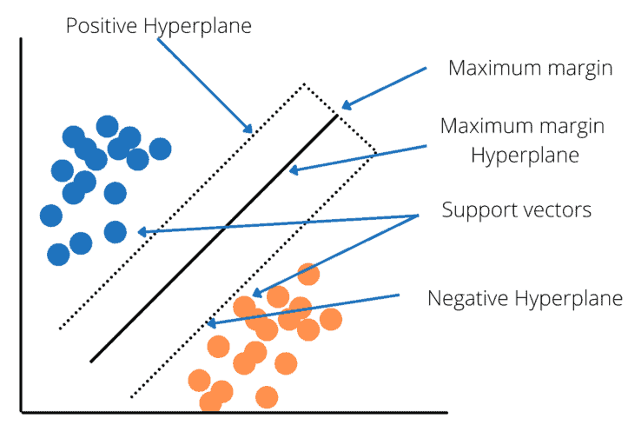
Regression Models: Support Vector Machine (SVM)
Instead of single line, we use three lines…
Minimize error from the margin hyperplanes (in this case a line)
Q: If SVM is similar to Linear Regression, why is it still great?

Slide 15
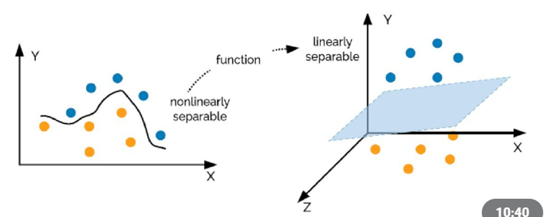
Regression Models: SVM (Non-Linear)
Non-Linear approach: trick SVM with preprocessing
Use a NON-LINEAR Kernel
Expand input into higher dimensions
G(x₁,x₂) = (f₁(x₁,x₂), f₂(x₁,x₂), f₃(x₁,x₂))
Ex: (x₁,x₂) => (x₁², x₁ * x₂, x₂²)
Application of linear algebra
Read more: https://www.semanticscholar.org/paper/Subspace-Embeddings-for-the-Polynomial-Kernel-Avron-Nguyen/503347a28184ec6d92137cfcab11a2f862318fcb

Slide 16
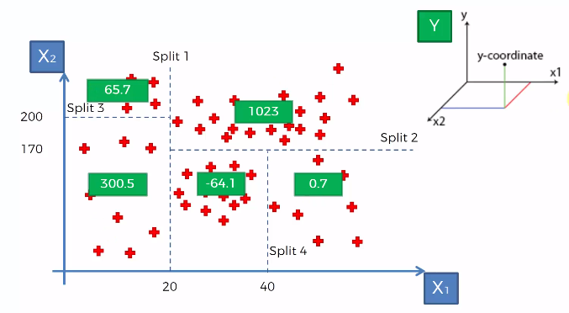
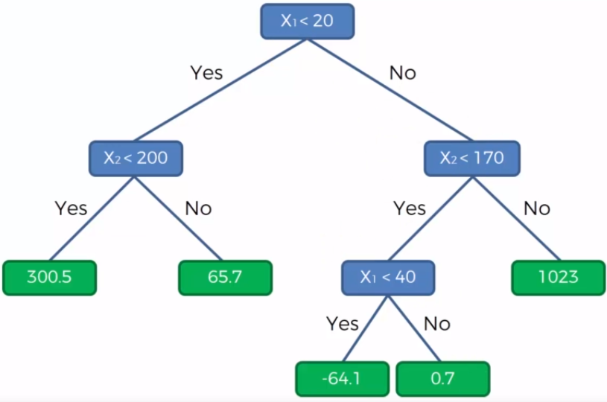
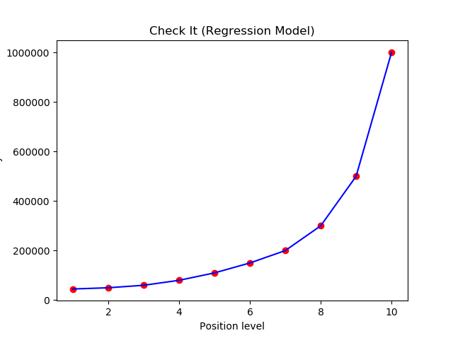
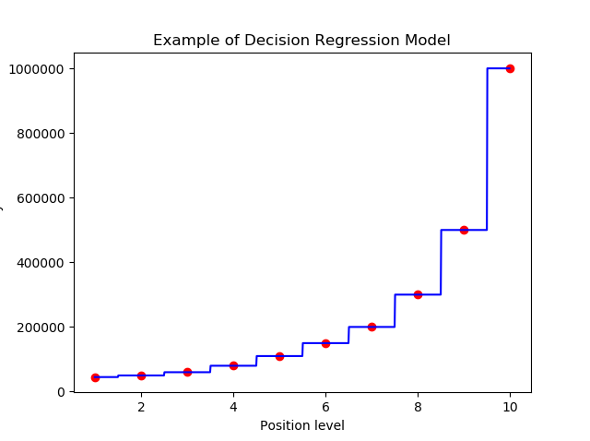
Regression Models: Decision Trees
Similar to barebones AI approach: will create a decision tree
For small tree, predicted output is not diverse
Deceptively simple - Q: Is this model good?

Slide 17
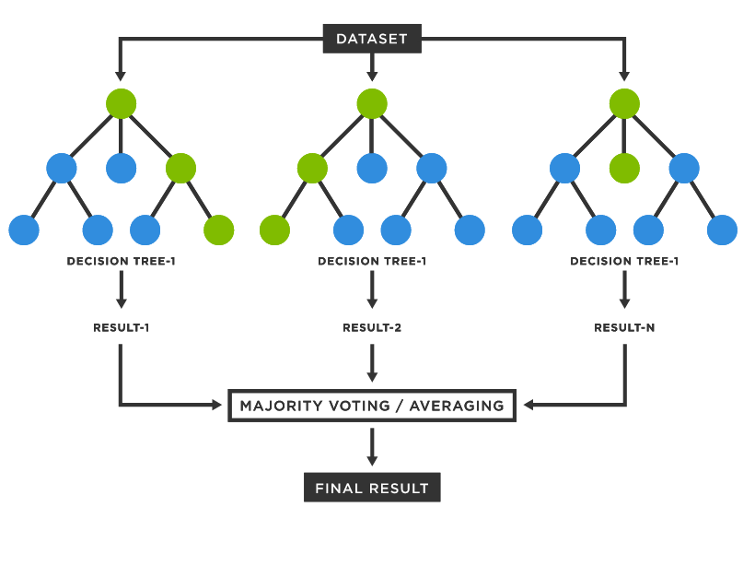
Regression Models: Random Forest (and Boosted Tree)
Random Forest: create a forest from the trees
Use multiple models and process output to be a single value (averaging, etc.)
Q: Assuming unlimited resources, can we apply a similar strategy with different model types?
Boosted Tree: applied linear algebra to make branches less linear

Slide 18
Demo: SciKit Learn Regression Models
Let’s make some models!
Demo: https://colab.research.google.com/drive/15-MlDJO65SOCO94lEln8NVGxPLCbINKj?usp=sharing
Completed: https://colab.research.google.com/drive/1ic-vuruLPb4slWY9p19tiGQxST88qpvY?usp=sharing

Slide 19
Tips and Resources
You have all the tools to make a price prediction model using real data (Give it a shot!)
Dataset is “Muni_raw.csv” (https://storage.cloud.google.com/bond_model_storage/Datasets/Muni_Raw.csv?authuser=3)
Alternatively can get data from bigquery directly
Load data into notebook/locally and train a model (Predict “Dollar Price of Trade” column)
Always remember to scale your data and save some to evaluate your final model
Many Classification models use the same underlying logic as Regression models: https://www.google.com/url?q=https://towardsdatascience.com/a-beginners-guide-to-text-classification-with-scikit-learn-632357e16f3a%23660b&sa=D&source=editors&ust=1657920371623678&usg=AOvVaw0l7ID4OPSLAQAGk7RvxzKC

Slide 20
General Model Construction Resources
Old Notes (Concepts): https://docs.google.com/document/d/1KJNkYVZKYHmi3cO5hdP_Ce1UCKE9ThJPyDMBi-ZEMzM/edit?usp=sharing
Colab Notebooks (Code): https://drive.google.com/drive/folders/1OFNnrHRZPZ3unWdErjLHod8Ibv2FfG1d?usp=sharing

Slide 21
Looking Forward: Evaluation Metrics
Generally minimize mean squared error or absolute error when training
Save a portion of initial dataset for validation (run model, calculate accuracy)
SciKit Learn API: https://scikit-learn.org/stable/modules/model_evaluation.html

Slide 22
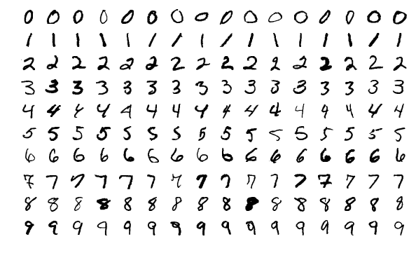
Looking Forward: MNIST Classification
https://scikit-learn.org/stable/auto_examples/classification/plot_digits_classification.html

Slide 23
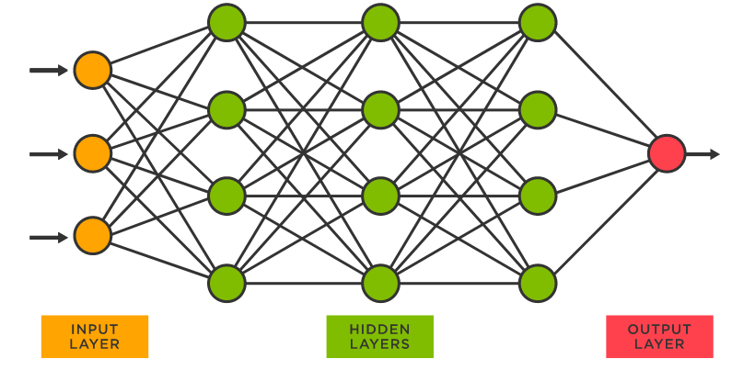
Looking Forward: Neural Networks
The future of AI: Deep Learning (made possible by neural networks)
Notes:
Neural Networks: for next time

